Slide 1
Read Me: AS Simulator for GIT
Ian McFarlane
2020-09-17
UC Berkeley
Landry Lab

Slide 2
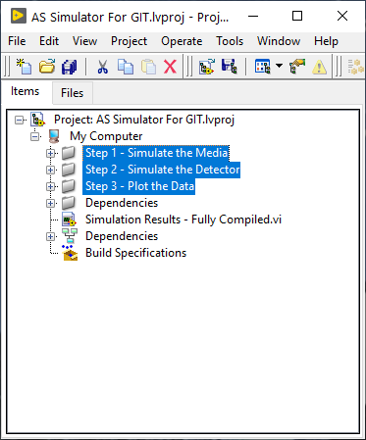
The Project
Start by opening the project file
“AS Simulator for GIT.lvproj”
There are three steps you will need to perform to use this system
Simulate the Media
Simulate the Detector
Plot the Data

Slide 3
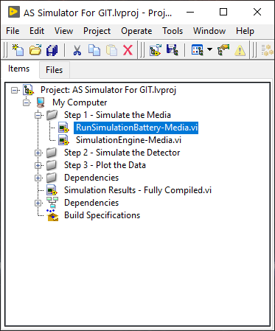
Step 1: Simulate the Media
In this virtual folder are two Vis
The thing to run: “RunSimulationBattery-Media.vi”
The primary subVI: “SimulationEngine-Media.vi”

Slide 4
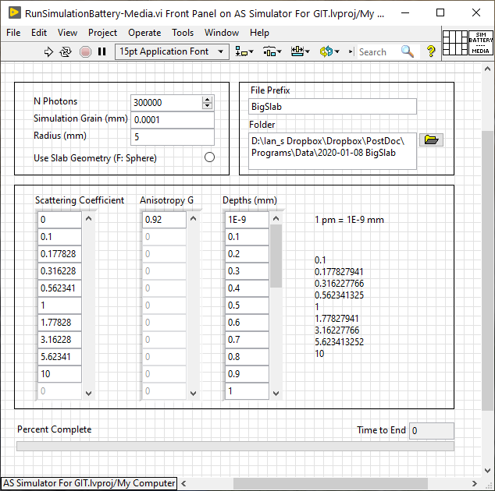
Step 1: Simulate the Media
Input the conditions for the simulation
Then run (ctrl-R)

Slide 5
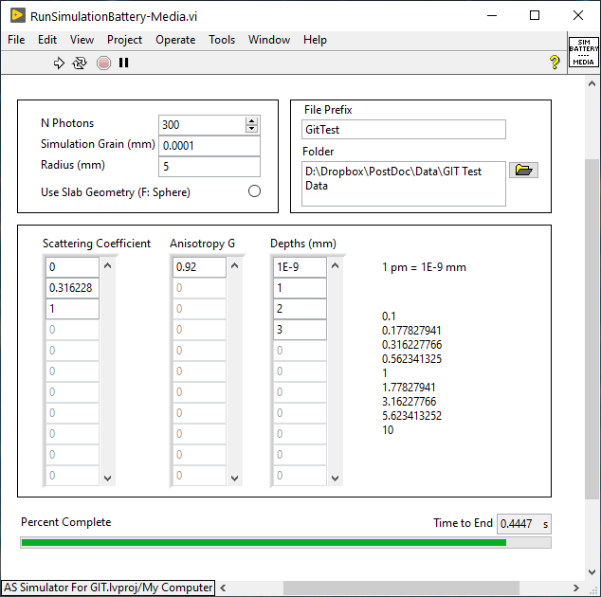
Step 1: Simulate the Media
In this example only a small amount of parameter space is explored

Slide 6
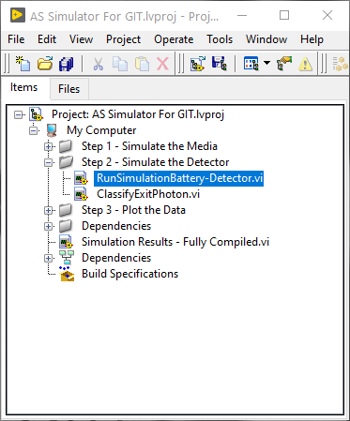
Step 2: Simulate the Detector
In this virtual folder are two Vis
The thing to run: “RunSimulationBattery-Detector.vi”
The primary subVI: “ClassifyExitPhoton.vi”

Slide 7
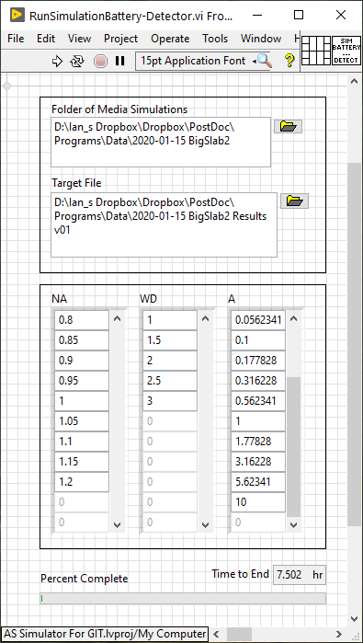
Step 2: Simulate the Detector
Input the conditions for the simulation
Then run (ctrl-R)

Slide 8
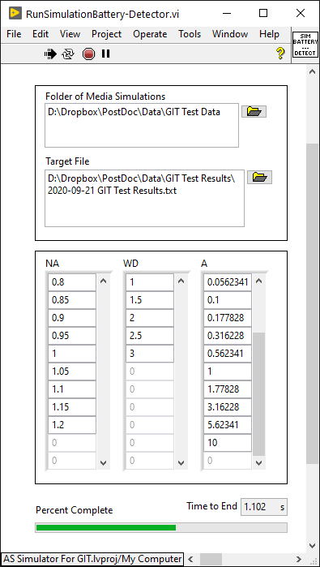
Step 2: Simulate the Detector
In this example only a wide parameter space is explored quickly because the data produced was so limited

Slide 9
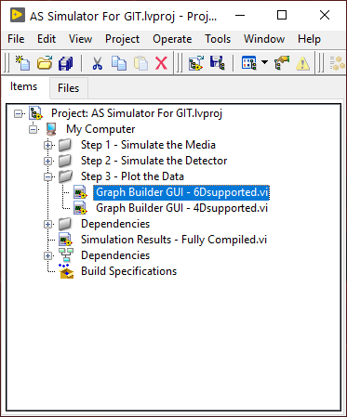
Step 3: Plot the Data
In this virtual folder are two Vis
Explore all microscope objectives: “GraphBuilderGUI – 6Dsupported.vi”
Explore a single microscope objective: “GraphBuilderGUI – 4Dsupported.vi”

Slide 10
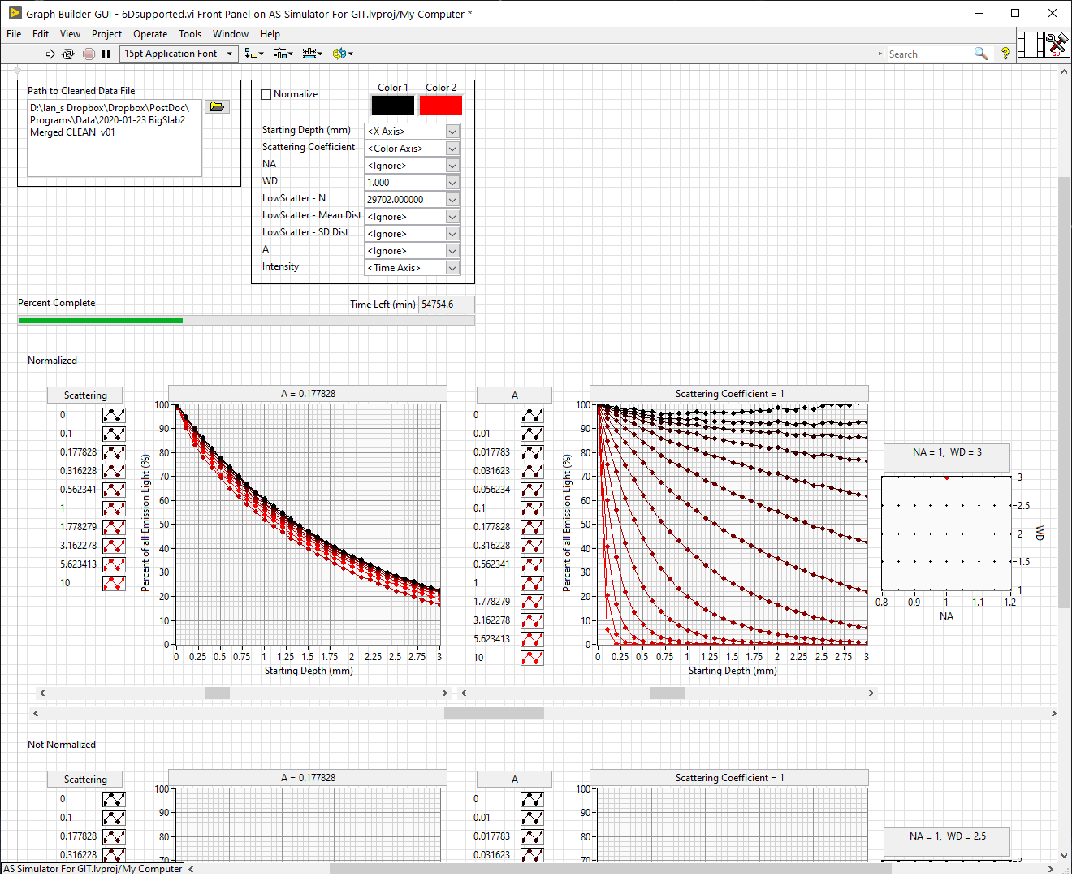
Step 3: Plot the Data
Select the axes to view, then scroll to explore the data

Slide 11
